Slide 1
FSL 211
Inner-Coex

Slide 2
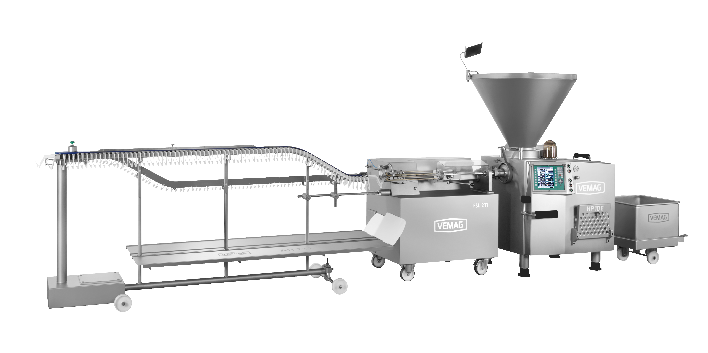
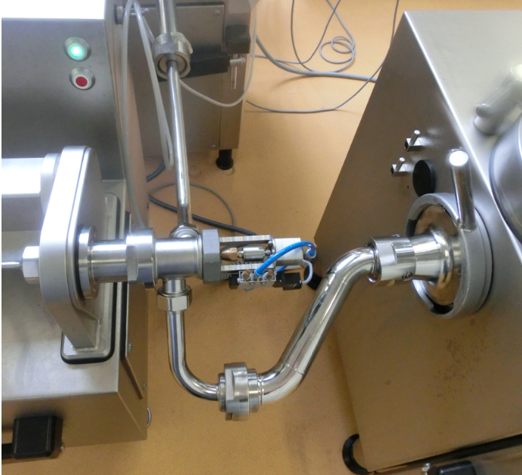
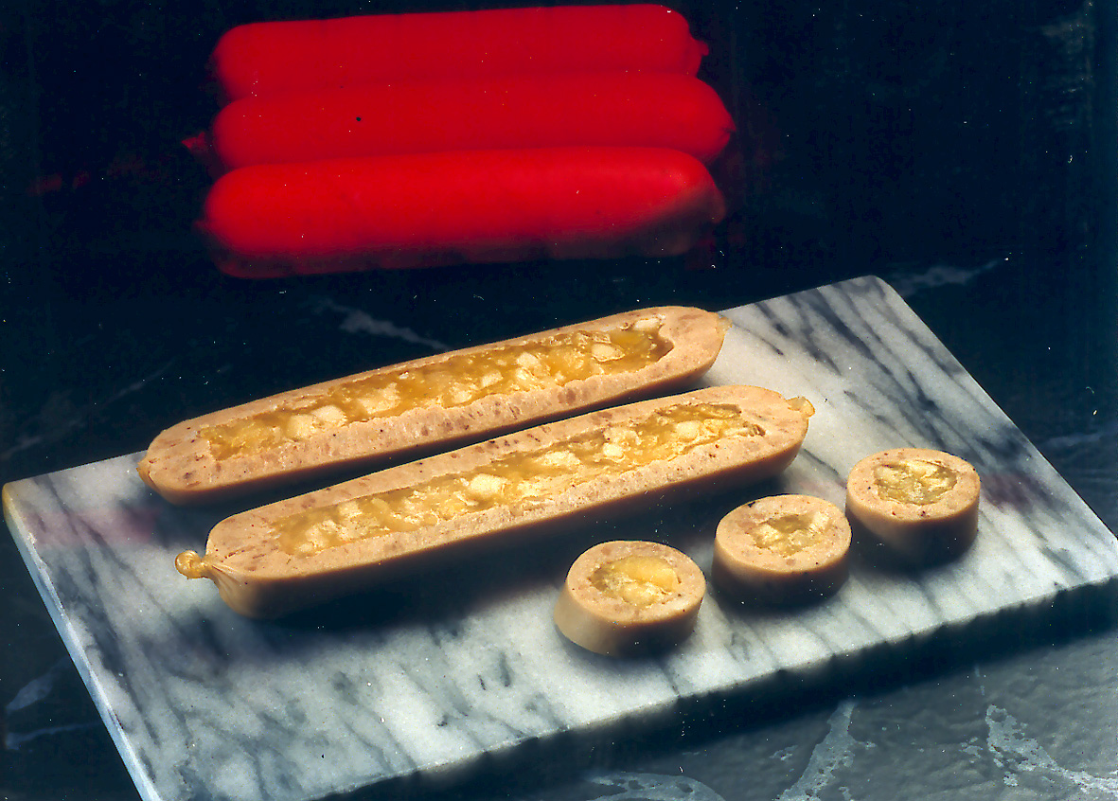
FSL with inner-Coex

Slide 3
Video

Slide 4
Basic Data
Basic Data
All prevalent casing types as well as Veggie casings
Caliber 20 – 40 mm
Sausage length starting with 40 mm
210 P/min with Coex unit
600 P/min for standard applications

Slide 5
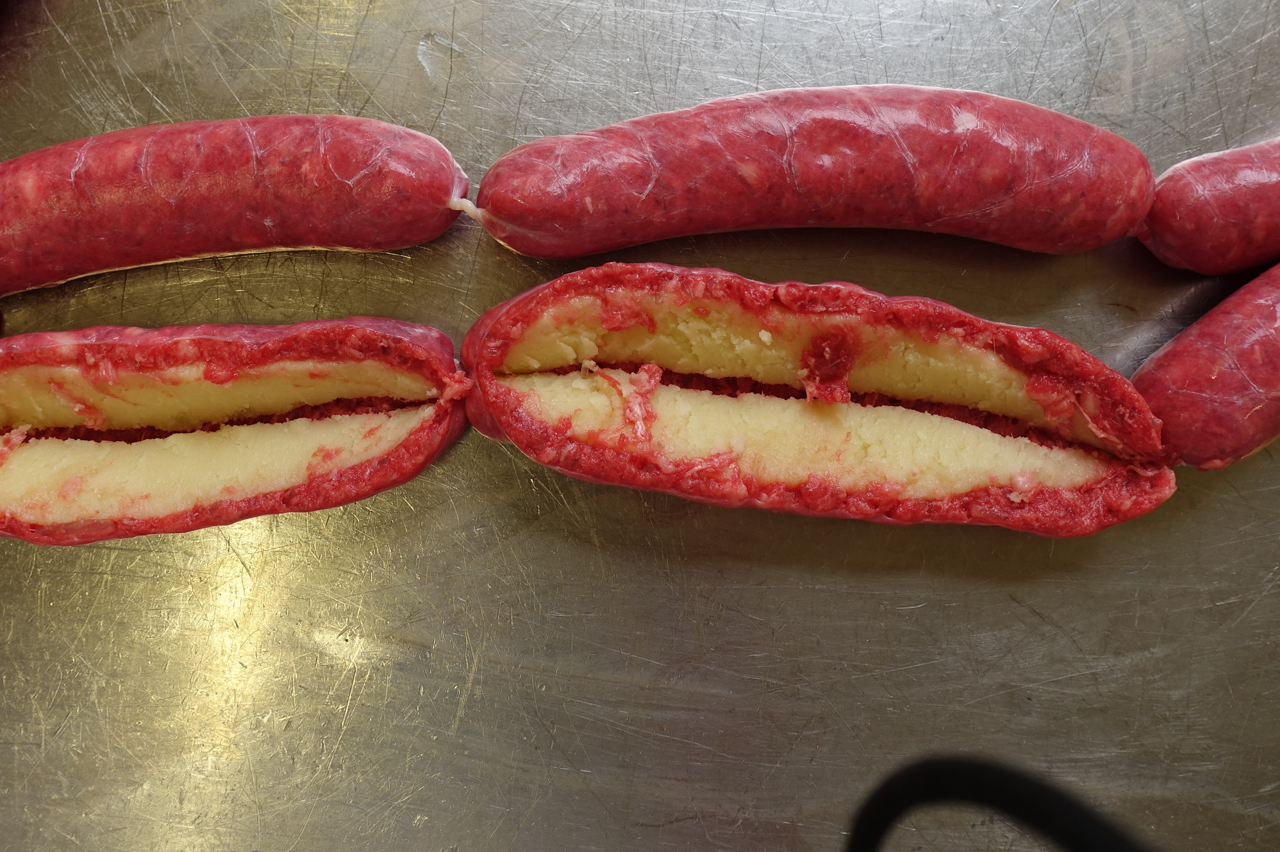
Basic Data
Your benefits using the FSL 211
Exact length and weight control for better yields
Length portioning, inner filling and hanging in one step
Easy and simple to adjust
Optimal placement of the inner filling
New product designs in minutes
For all linking application

Slide 6
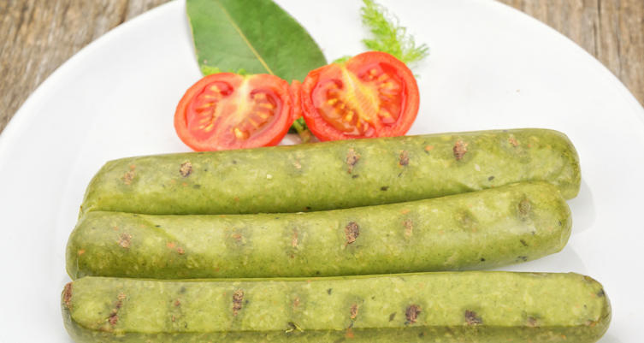
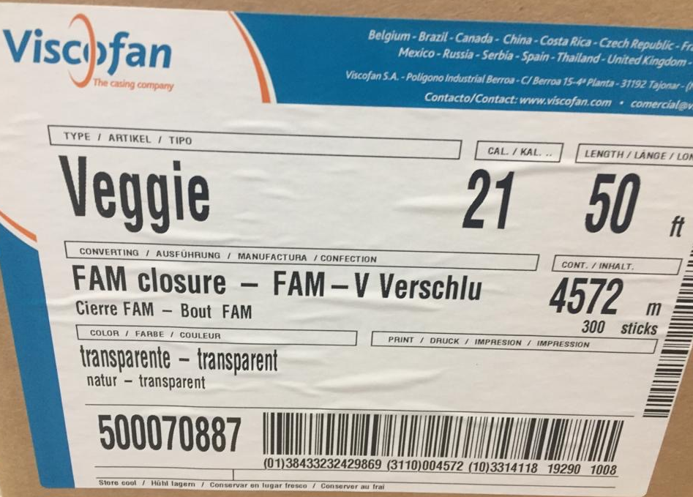
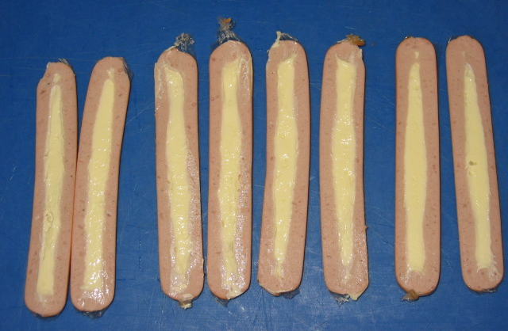
What´s your application ?
New products for the market
Refine existing product
Get creative

