Slide 1
VEMAG
Small and medium sized filling machines

Slide 2
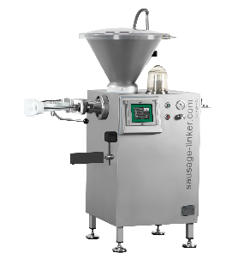
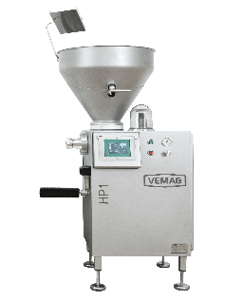
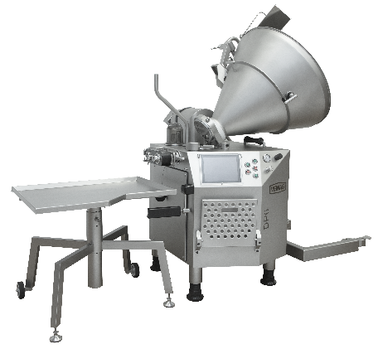
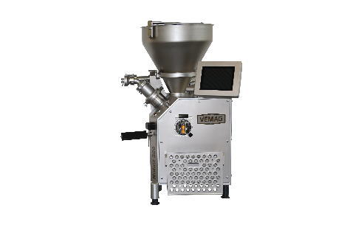
Small and medium sized filling machines
Sausage-Linker
Robby
HP1
Robot 500
DP6

Slide 3
VEMAG
Vane cell machines

Slide 4
VEMAG
Robby

Slide 5
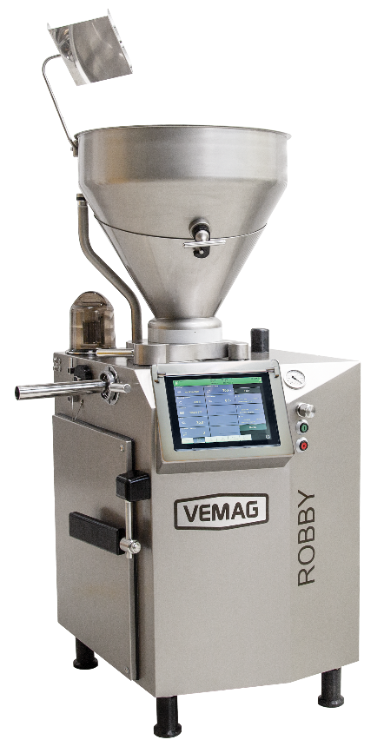
Robby
Filling capacity up to 2.3 t/h
8-chamber rotor
12" touch screen
Motor 2,75 kW servo motor
Hopper size 105 l split
Filling / linking / portioning of all types of sausages with DHV or clipping machines
Small to medium sized craft businesses
Koex-B machine
Convenience BC237, filling head 981

Slide 6
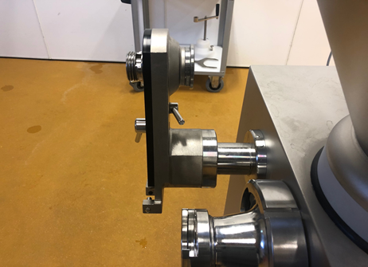
Robby Optionen
Standard twisting Solid State
Servo twisting for increased twisting capacity ( mandatory when using DHV815)
40 l hopper with plastic safety lid
100l hopper, one-piece
250l hopper, one-piece for external feeding
Linking gear box fixed, can be swivelled in from above
Chassis
Conveyor system for hot filling
Conveyor system for hot and cold filling Installation only at the factory or by VEMAG Service

Slide 7
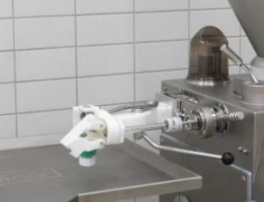
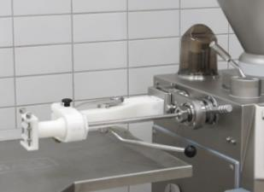
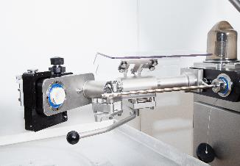
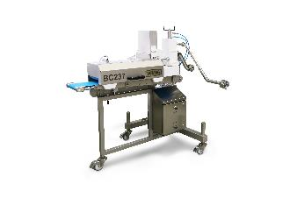
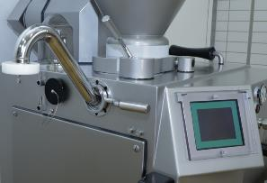
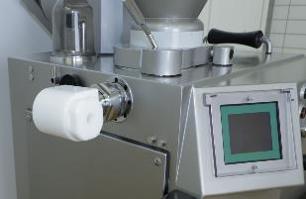
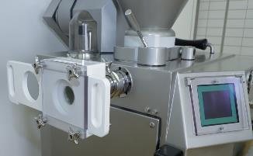
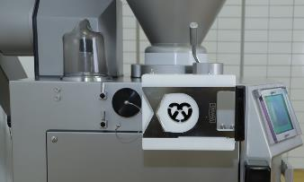
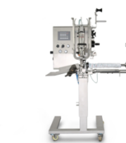
Robby Applications
DHV937
LPV802
DHV815
BC237
Can filling horn 908
MSF 931
MPF818
MCO818
All
Clipping machines

Slide 8
VEMAG
DP6

Slide 9
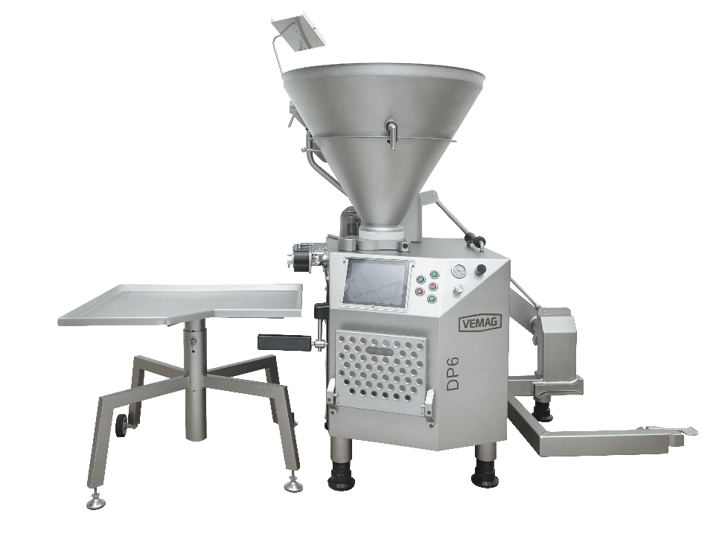
DP6 Basic
Filling capacity up to 2.7 t/h
8-chamber rotor
12" touch screen control
drive motor 3,5 kW servo motor
hopper size 250 l one piece
Filling / linking / portioning of all types of sausages with DHV or clipping machines
Medium sized businesses
Koex-B machine
Convenience BC237, filling head 981

Slide 10
DP6 Optionen
Standard twisting unit for AG 859 ( For DVH937 and LPV802)
Servo twisting unit for AG 859 ( For DHV937 and LPV802)
Servo twisting unit for AG899 ( Only in combination with DHV815)
Lifting device for 200L trolley, sideways or backwards loading
Lifting device for 120L trolley, rear loading
250 l Hopper split
16cm3 vacuum pump and ejector vacuum pump
Conveyor for hot filling
Conveyor unit for hot and cold filling → Installation only at the factory or by VEMAG Service

Slide 11
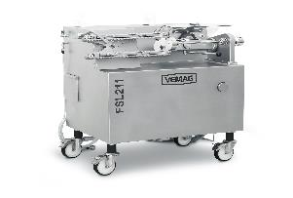
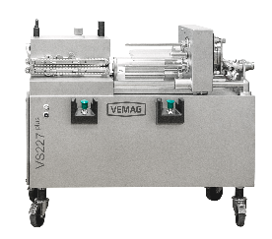
DP6 Anwendungen
DHV937
LPV802
DHV815
BC237
Dosenfüllrohr
MSF 931
MPF818
MCO818
VS227 plus
Alle Clipmaschinen
FSL210/211

Slide 12
VEMAG
Double screw machines

Slide 13
VEMAG
Sausage- Linker

Slide 14
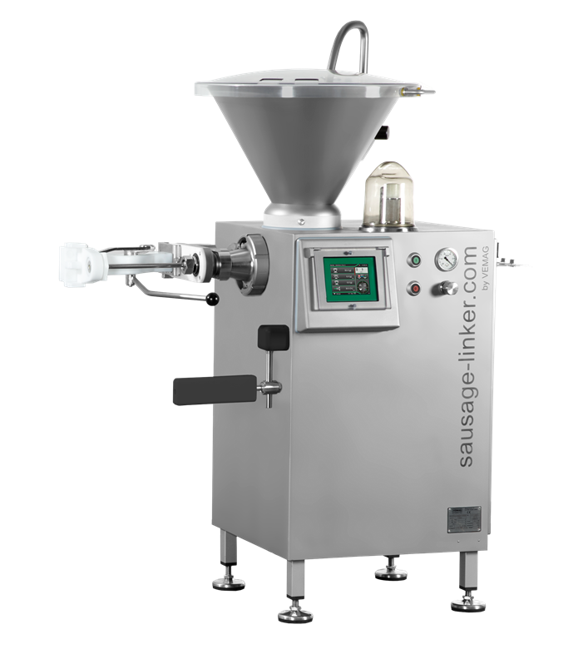
Sausage-Linker
Filling capacity up to 2 t/h
Motor drive 2,75 kW servo motor
Double screw 24C/36/24 HPZ ø62
Solid state linking
Linking gearbox is fixed
40 l hopper with plastic safety lid
DHV937 short without roller guide

Slide 15
Sausage-Linker - Options
DHV937 short with roller guide
DHV937 long without roller guide
DHV937 long with roller guide
Remote control socket for clip applications
Toolbar

Slide 16
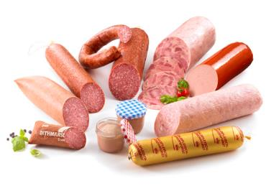
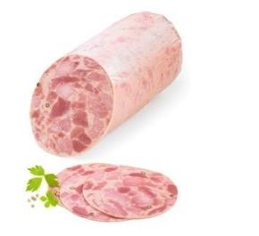
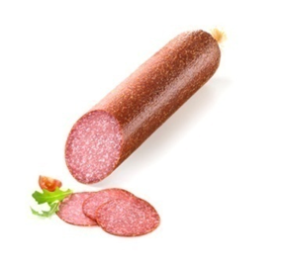
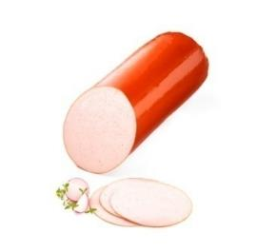
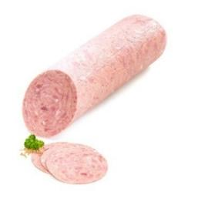
Sausage-Linker
Filling / portioning of all types of sausages
Small craft businesses or "company founders
Transition from piston filler to vacuum filling machine

Slide 17
VEMAG
HP1

Slide 18
HP1 Variants
HP1 Bakery
HP1 Filling, portioning, clipping
HP1 Filling, portioning, clipping and twisting
HP1 CAN Bus
Also available as HT version with 390rpm for bakery and Grinder applications

Slide 19
HP1 - Basismaschine
Filling capacity from 2.0t/h – 2,6t/h (depense on the used double screw)
Drive motor 2,75 kW servo motor
7" touch panel with control
hopper size 105 l split, standard
Vacuum pump 16 m³/h
For each HP1 a housing, a double screw and a filling horn holder or Wolf985 must be selected.

Slide 20
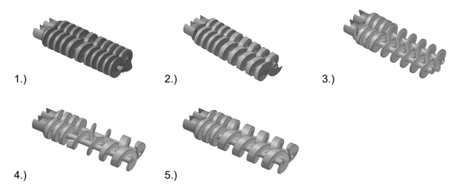
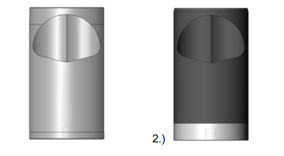
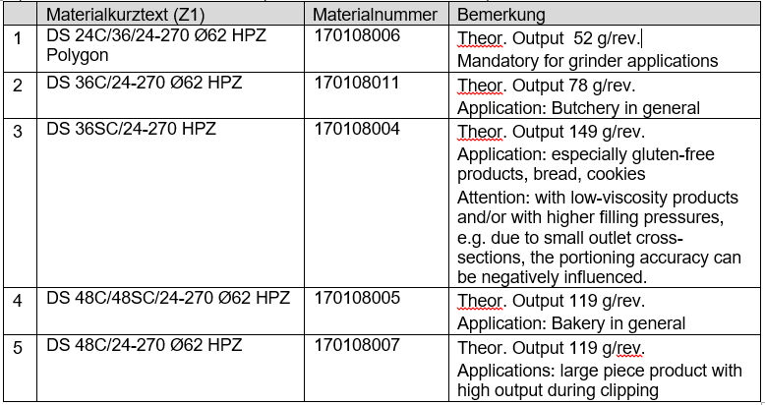
HP1 – Must haves
Housing:
DS-housing 194-70/100-ø62 POM
FK-Gehäuse 194-70/100- ø62 Hiresist
Double screws:

Slide 21
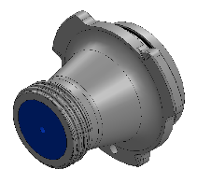
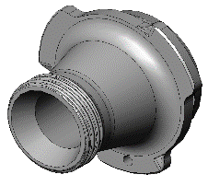
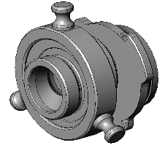
HP1 – Must haves
Filling horn holder:
Filling horn holder with nozzels
Filling horn holder for attachments ( BC237)
VEMAG Grinder 985 - Ø 70mm
For simultaneous grinding and filling for masses down to -1°C
Not suitable for separation
Consisting of:
Filling mincer housing
Shaft to drive the grinder in connection with a special pair of double screw
Cutting set parts can only be used in 3 parts
Pre-cutter
knife 4 blades
end hole disc 3/4/5/6 and 7,8mm

Slide 22
HP1 – Options
40L hopper with security lid
Ejector pump
Chassis
Solid state twisting
CAN BUS
Tool bar

Slide 23
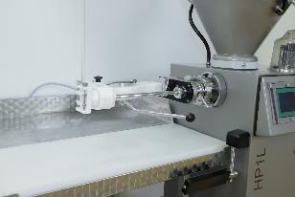
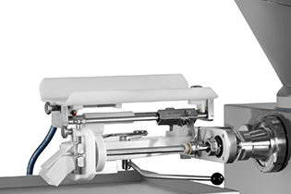
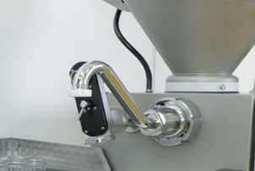
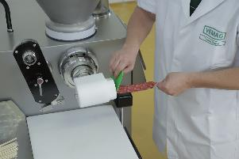
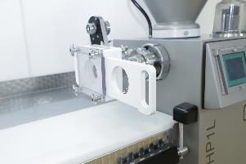
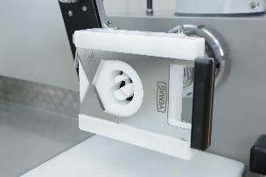
HP1 Anwendungen
DHV937
LPV802
DHV841
BC237
Can filling horn 908
MSF 931
MPF818
MCO818
All
Clipping machines
FSL210/211

Slide 24
VEMAG
Robot 500

Slide 25
Robot 500 Typ 174
For soft masses:
For clipping
For twisting
Filling head
As Koex B machine
Bakery
Etc.
For grinder application and solid masses
With filling grinder 980
As High Torque
With pneumatic separation

Slide 26
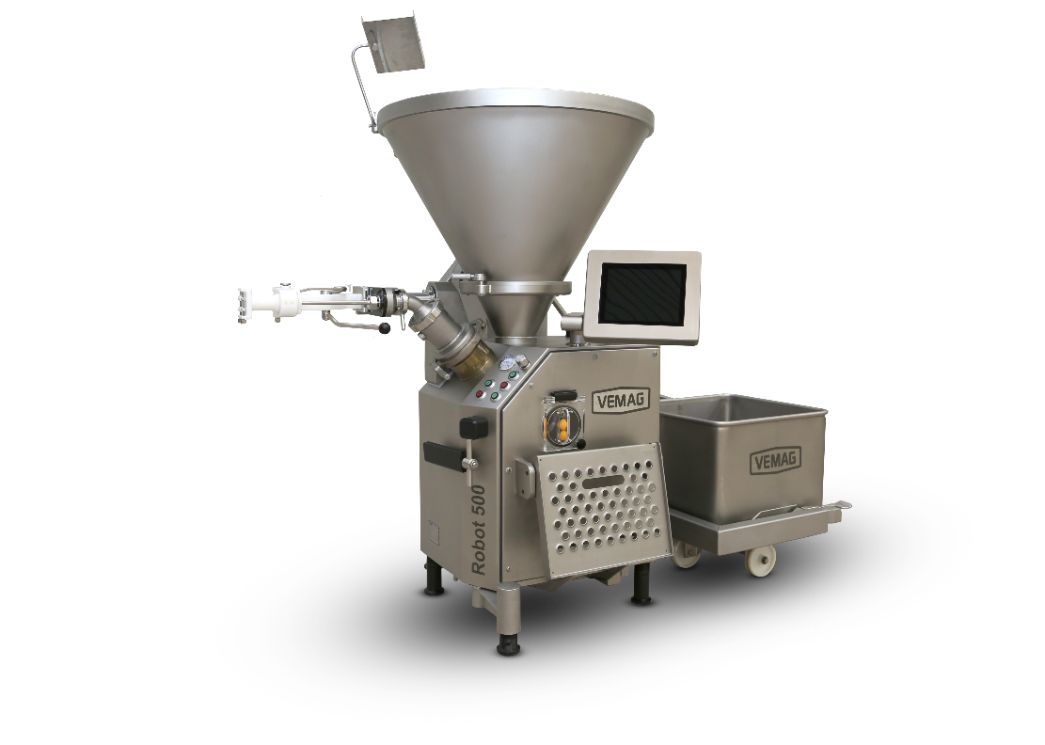
Robot 500 Typ 174 Models
80 OMR hydraulic motor rpm 300
Output 2,8 t/h → DS 48
High portioning capacity, linking without sausage grinder 980, cooked sausage
125 OMR hydraulic motor rpm 190
Output 1,8 t/h → DS 48
For stiff masses, without any grinder
160 OMR hydraulic motor rpm 150
Output 1,4 t/h → DS 48
Bakery applications and sausage grinder 980
200 OMR hydraulic motor rpm 120
Output 1,1 t/h → DS 48
For fondant and similar products

Slide 27
Robot 500 Typ 174 Basics
Equipped with VEMAG double screw technology
CAN bus
Based on a hydraulic system proven over many years
Compatible with all current VEMAG attachments
Can be combined with all clipping machines
110 l hopper divided
16 cbm vacuum pump
Operation via 12``Touch Panel
VEMAG standard connection for attachments
80 mm x ¼ round
35 pin remote control cable

Slide 28
Robot 500 Typ 174 Options
Elevator with side or rear insertion
40 cbm vacuum pump
Twisting off
Integration of different weighing systems
230 l hopper divided

Slide 29
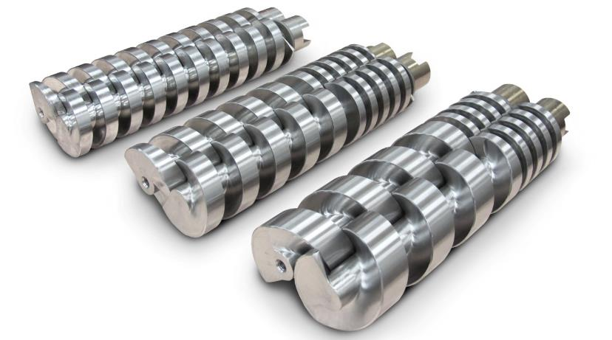
Robot 500 Typ 174 Options
Adjustment of the output rate as well as optimization of the product quality:
Through different double screws
Only standard crews with a length of 367mm can be used!!!
Use of the master curve is not possible!!!!

Slide 30
Robot 500 Applications
DHV937
LPV802
DHV841
BC237
Can filling horn
MSF 931
MPF818
MCO818
All
Clipping machines
FSL210/211
CC215

